Slide 1
January 21, 2016

Slide 2
AGENDA
Welcome - Steven Glyer
CTE EF Update
Data Unlocked
Nick Kremer
WIOA
DOW
Chancellor’s Report - Robin Harrington and Carol Jong
LATT Labor Grant Presentation - Leticia Barajas and Jess Guerra
Announcements
Stephanie Feger - OC SB1070 Internship meeting
Kari Irwin - CCCAOE - Feb DeepDive Roundtable
Lyla Eddington - LACC & LA WIOA

Slide 3
CTE EF Update
CTE EF 3rd quarterly report is due TODAY……(if you need an extra day, email Janeth)
Rancho SCCD internal audit department will begin communication with colleges for CTE EF auditing process.

Slide 5
Board of Governor’s 25 Recommendations

Slide 6
Board of Governor’s 25 Recommendations
Student Success
Career Pathways
Workforce Data and Outcomes
Curriculum
CTE Faculty
Regional Coordination
Funding

Slide 7
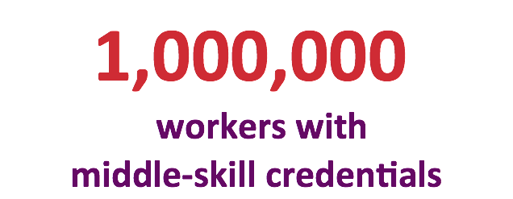
Board of Governor’s 25 Recommendations

Slide 8
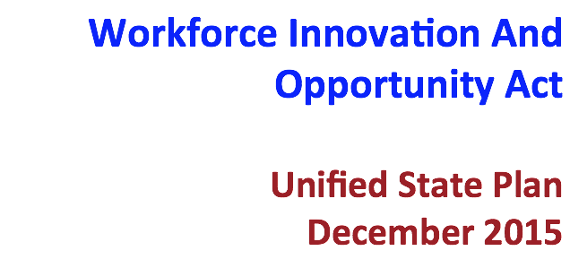
Board of Governor’s 25 Recommendations

Slide 9
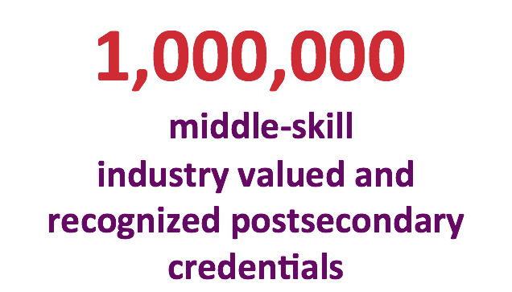
Board of Governor’s 25 Recommendations

Slide 10
Board of Governor’s 25 Recommendations

Slide 11
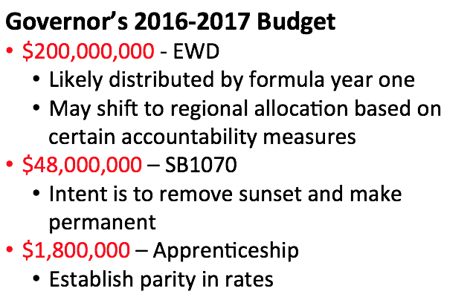
Board of Governor’s 25 Recommendations

Slide 12
Data Unlocked – Find It, Understand It, Use It
Build Awareness
Deepen Expertise
Support College Data Use
Expand Regional Data Use
Spring 2016
Regional workshops offering a hands-on introduction to CTE data tools
(Required to apply for funding)
Summer 2016
Train a cadre of technical assistance providers
Fall 2016
Each college gets:
$50,000 + 10 hours of support
Online resources
Super-user training
CTEOS & CATEMA
Spring 2017
Regional data analysis and planning meetings around one priority occupational area

Slide 13
Board of Governor’s 25 Recommendations

Slide 14
Nick Kremer
Co-Chair
LAOCRC

Slide 15
WIOA State Plan
Goal: One million “middle-skill” industry-valued and recognized postsecondary credentials.

Slide 16
WIOA State Plan -- Objectives
Fostering “demand-driven skills attainment”
Enabling upward mobility (especially for populations with barriers to employment
Aligning, coordinating and integrating programs and services

Slide 17
WIOA State Plan -- Strategies
Organizing regionally
Sector strategies
Career pathways
Utilizing “earn and learn” strategies
Providing supportive services
Building cross-system data capacity
Integrating services and braiding resources

Slide 18
The DOW
Decision Making Processes and Organizational Structure Workgroup
Tentative plan for Spring
January & February -- Dow meetings
March -- Preliminary recommendations to SPC and full Consortium for discussion and input
April -- DOW revises recommendations
May --Bring revised recommendations to SPC and full Consortium in May for endorsement

Slide 19
Robin Harrington
Specialist
WF&ED Division
Chancellor’s Office

Slide 20
Chancellor’s Report - Robin Harrington
Perkins
Reauthorization
Title I-C Certification Form
Quarterly Reporting

Slide 21
Chancellor’s Report - Robin Harrington
Implementing Statewide Performance Strategies
Maintenance and Instructional Equipment
One-Time Discretionary Funding
Telecom and Technology Infrastructure Program
Proposition 39
Apprenticeship
Cost-of-Living Adjustment for Categorical Programs
Adult Education Block Grant (AEBG) 2016-17
Governor’s Budget
http://www.ebudget.ca.gov/FullBudgetSummary.pdf
http://extranet.cccco.edu/Portals/1/ExecutiveOffice/Board/2016_agendas/January/Item-4.3-Budget-Update.pdf
CCC Apportionments
COLA
Strong Workforce Program
CTE Pathways (SB 1070)
Basic Skills Program
Innovation Awards
Zero-Textbook-Cost Degrees
Proposition 39
Apprenticeship

Slide 22
Chancellor’s Report - Robin Harrington
BOG Task Force Update
Student Success Scorecard
http://californiacommunitycolleges.cccco.edu/Newsroom/PressReleases/2015PressReleases.aspx

Slide 23
Carol Jong
Specialist
WF&ED Division
Chancellor’s Office

Slide 24
Chancellor’s Report - Carol Jong
DSN 15/16 Grant Augmentation Docs
 | SB1402 (ends 6/30/16) | SB1070 (ends 12/31/16)
DESCRIPTION | $200K, Existing | $100K, Augmentation
WORKPLAN | Submit only if revised | Submit new
BUDGET | Submit re-signed summary budget | Submit detail budget & signed summary budget

Slide 25
Chancellor’s Report - Carol Jong
LAUNCHBOARD 2.0 TRAINING
What: CTE Data Unlocked and the LaunchBoard Program Snapshot
When: Feb 10th | 12pm-1pm
Where: CCC Confer
More at: http://bit.ly/1P33L2d

Slide 26
Dr. Leticia Barajas
Jess Guerra

Slide 27
Announcements
Stephanie Feger - Orange County SB1070 - Regional Internship Meeting today 11:15 a.m. - 12:15 p.m.
Kari Irwin - CCCAOE - February DeepDive Roundtable and April Joint Conference
Lyla Eddington - LA Community Colleges & LA WIOA today 11:30 a.m. - 3:00 p.m.

Slide 28
Until Next Time …………...
February Program Approval Cycle
Apps Due - Tuesday, Feb. 2, 2016
Voting Window - Feb. 9-16
PA Meeting - Feb. 18, 8:30 - 9:30
February Consortia Meeting
Thursday, Feb. 18, 2016
Data Unlocked & LB2.0
10:00 - 11:00
February DeepDive
Thursday, Feb. 18, 2016
11:15 - 12:15
CCCAOE Roundtable Discussion

